Slide 1
Recommendation based on Topic Models & Word Embedding Models on Wikipedia data
Xiaolong Yang
Xyang105@Illinois.edu

Slide 2
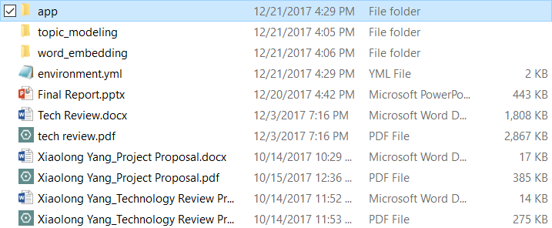


File list
Recommendation App,
what we want to use
Model
Training
Result,
We won’t use but there are some dependence,
So leave it alone and not delete

Slide 3
Software Dependencies
The app using Python 3.5
The app using following packages:
Flask
Metapy
Numpy
Pandas
You could use “pip install {packages name}“in command prompt,
If not, use Anaconda environment to set the environment (Next page)

Slide 4
Set environment in Anaconda
1. Download and install Anaconda at:
https://www.anaconda.com/download/
2. Open “Anaconda Navigator” and import environment:
(Next page)
3. Open “Anaconda Prompt” , go through the folder path, activate the environment “xyang105_app”
(Next Second page)

Slide 5
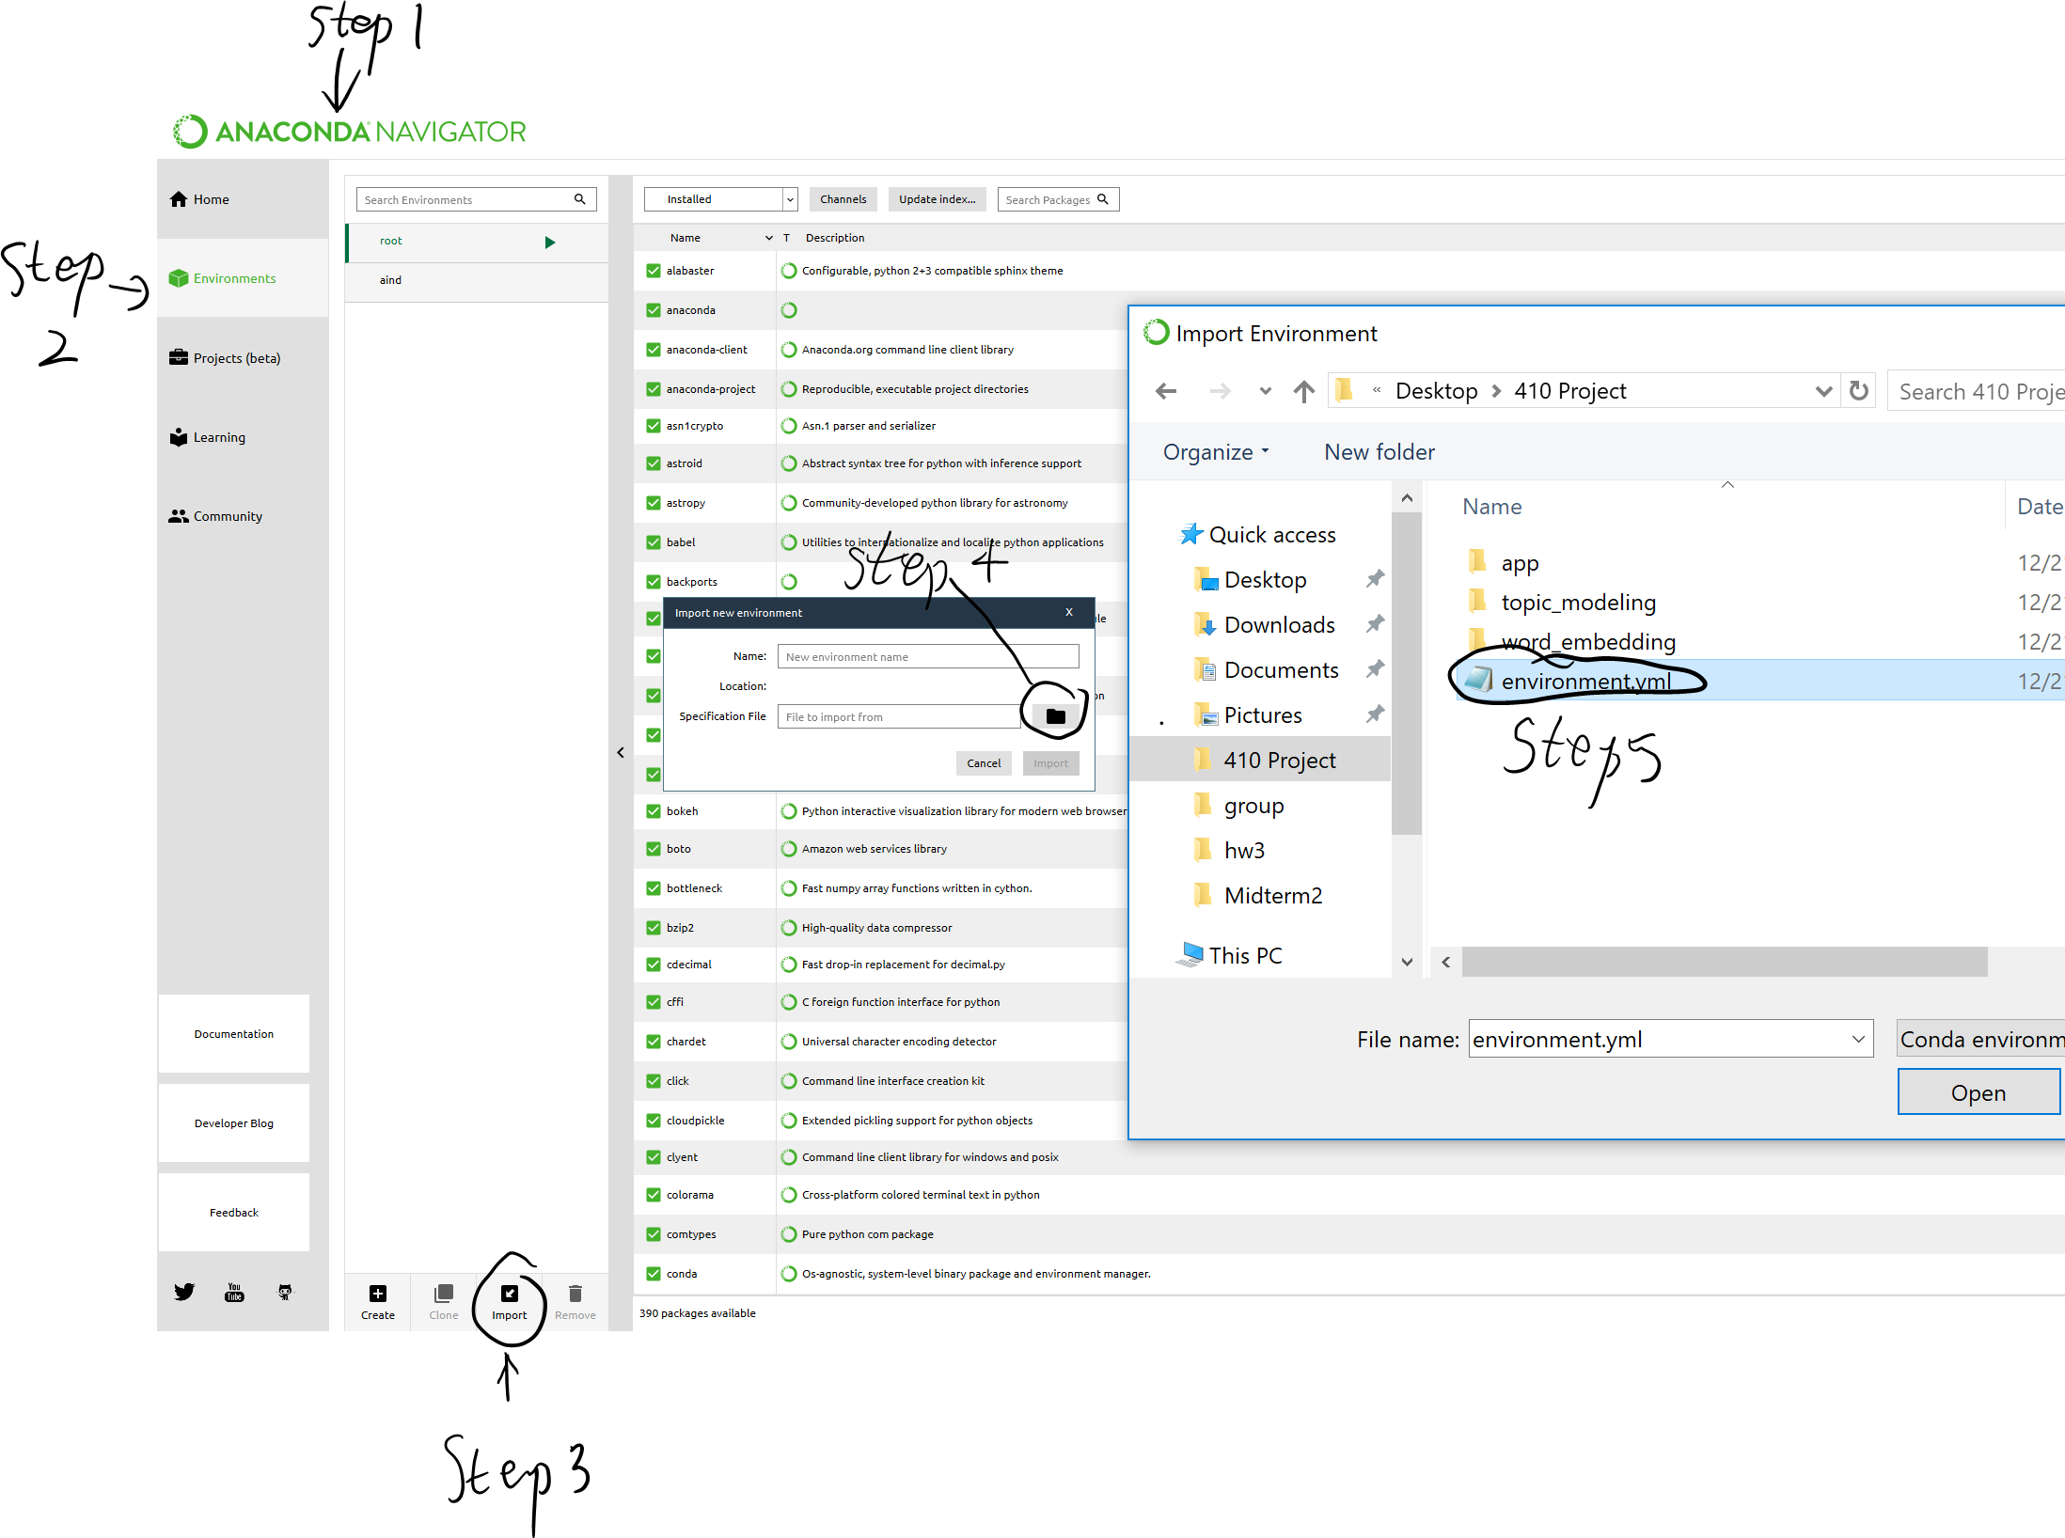

Slide 6
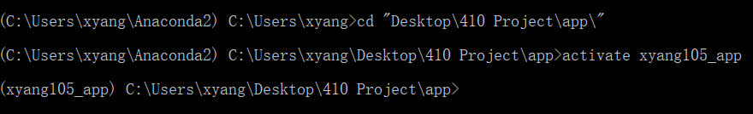

Go to the app path
Activate environment “xyang105_app”

Slide 7
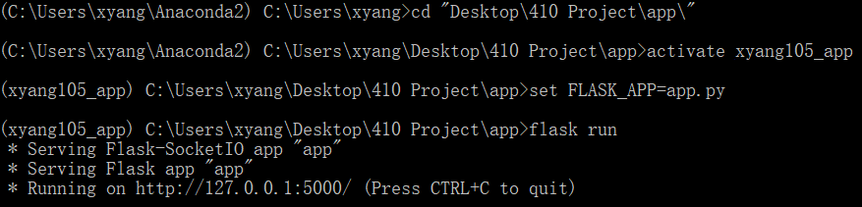

Set variables for flask and run flask
"set FLASK_APP=app.py" in windows
"export FLASK_APP=app.py" in Linux/Max OS

Slide 8
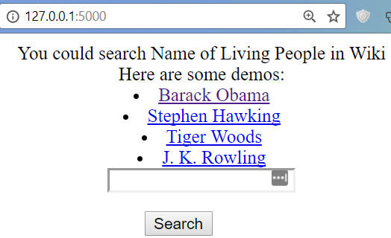
Go to the web app at http://127.0.0.1:5000/
Click on any of the demos or type your own

Slide 9
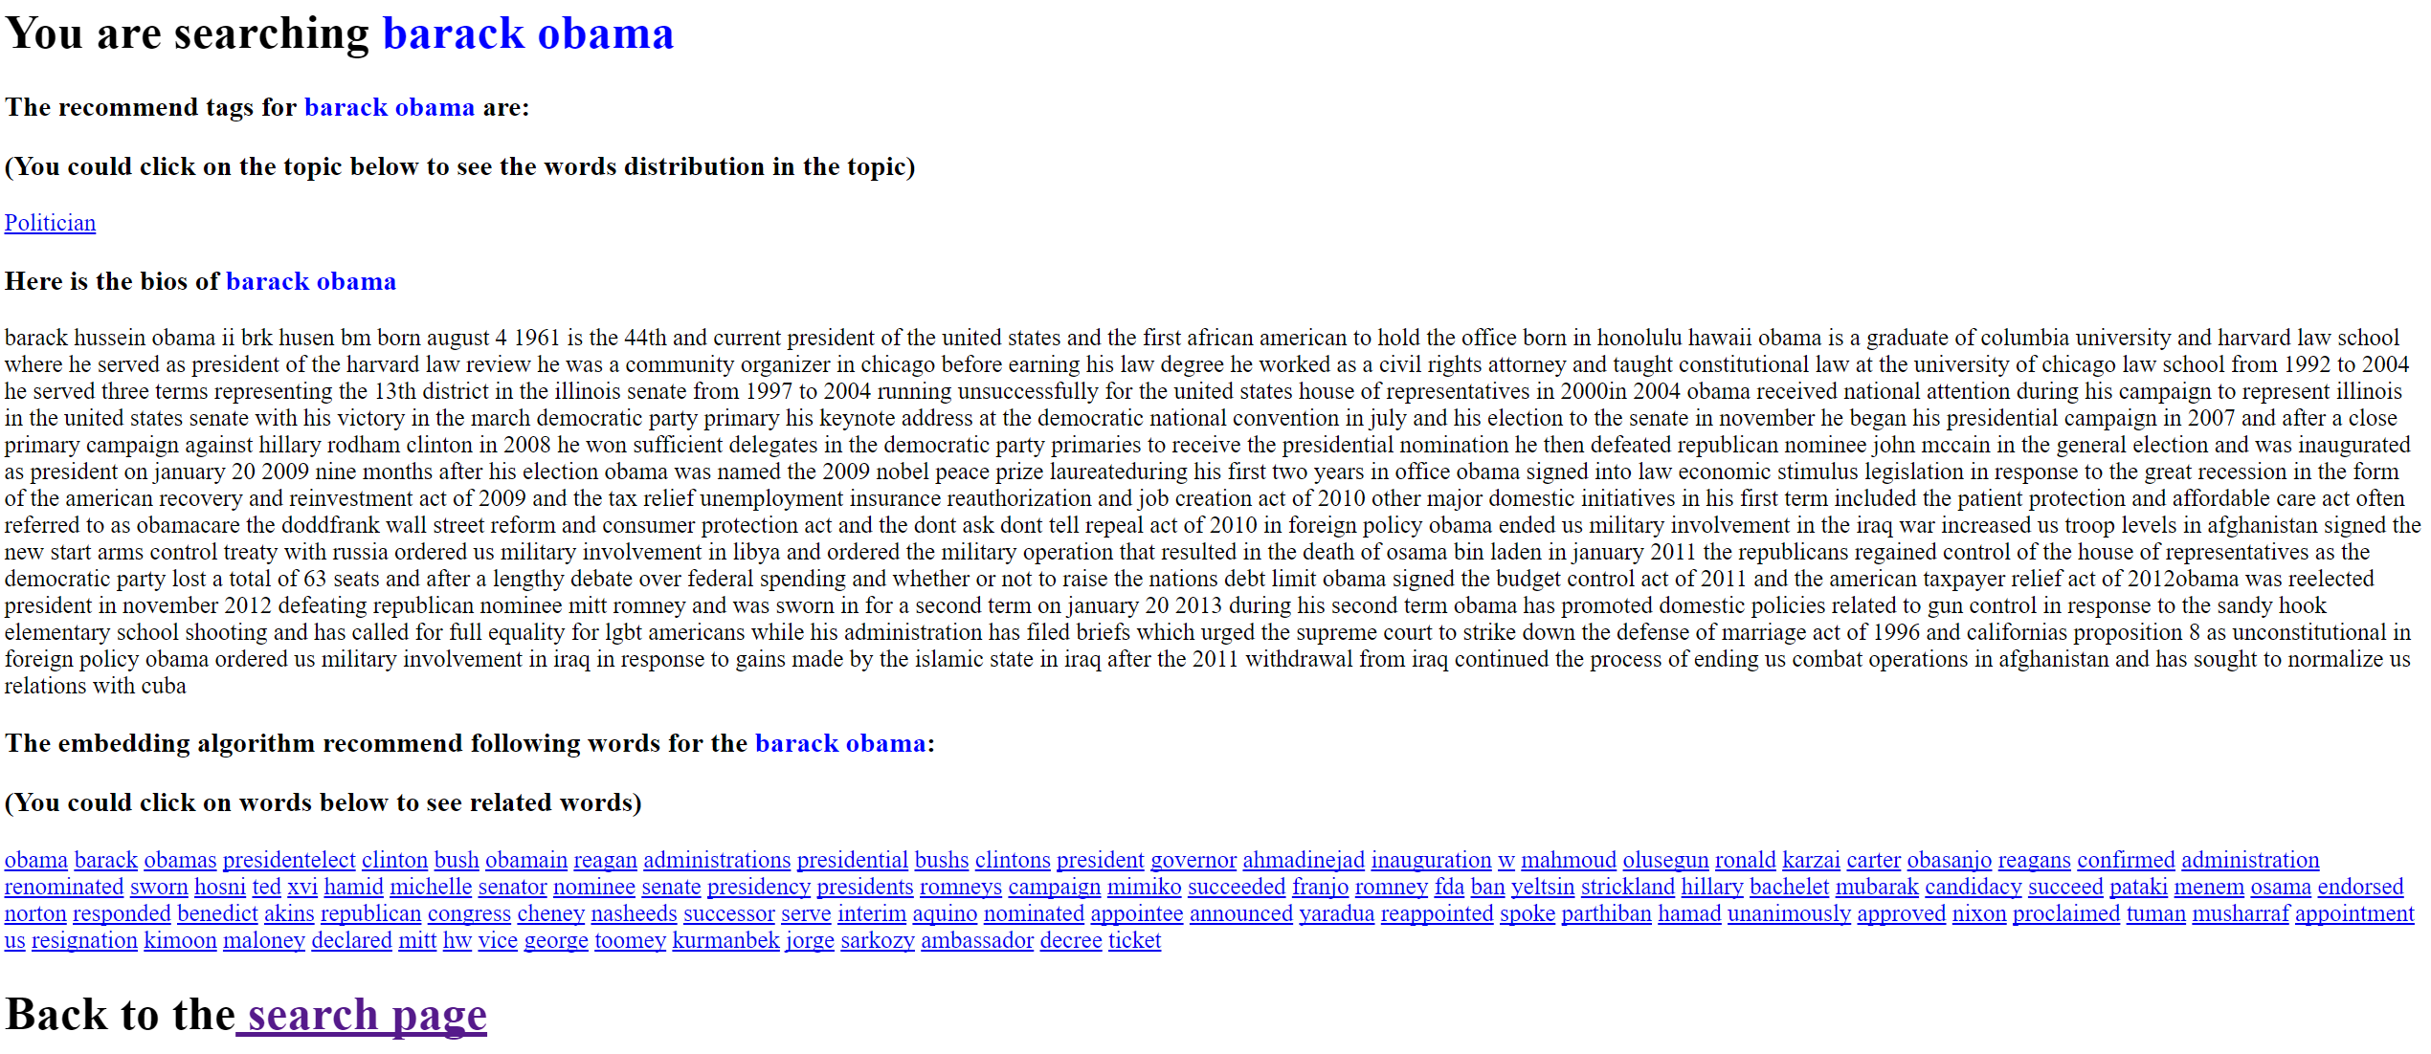
If you search a person in the system, it would return the person’s topic, bios and recommend words:

Slide 10
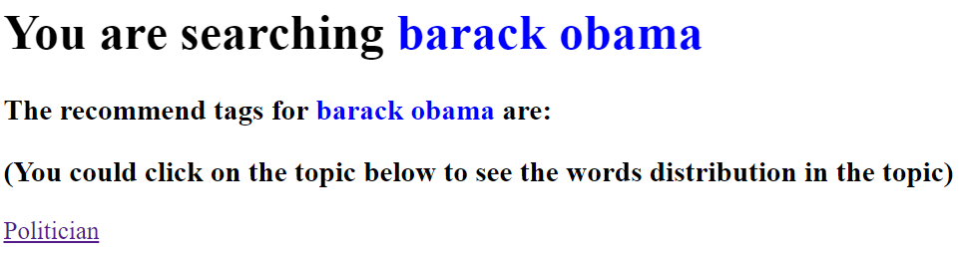
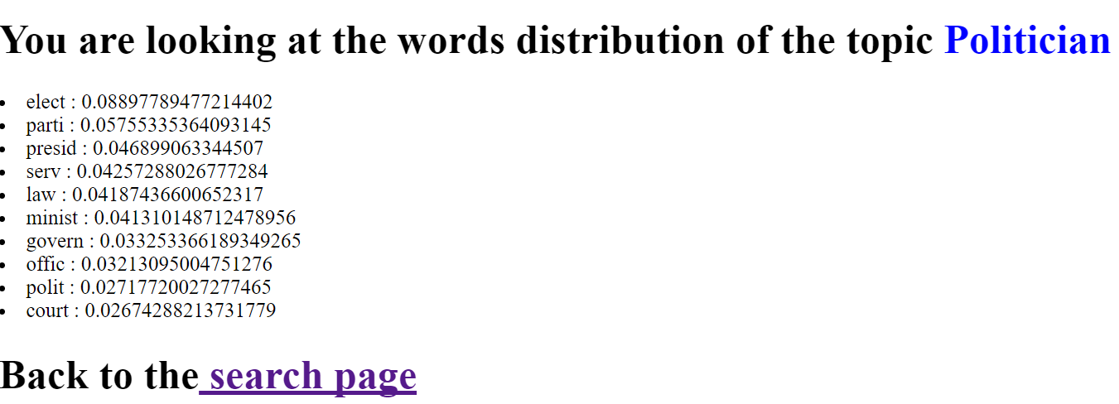


You could click on the topic tags to see the word distribution
word
weight

Slide 11
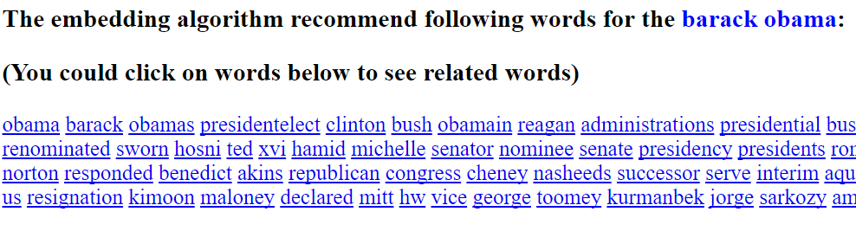
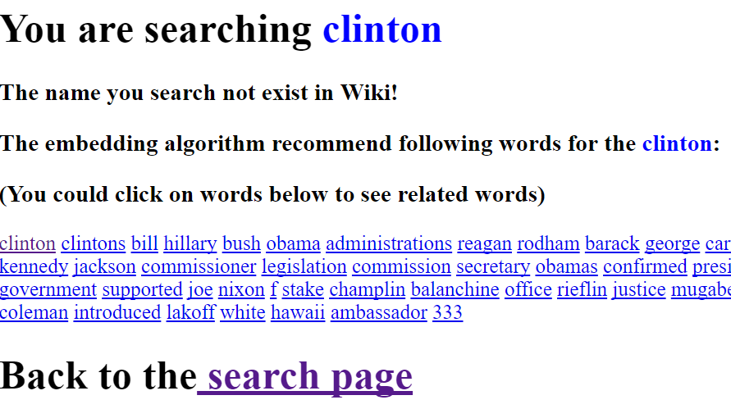



You could also click on the recommend words to see the related
The system require full name to search, if you search Clinton other than “Bill Clinton”, it won’t show the bios and topic, but it would still do the word embedding recommend

Slide 12
Thanks
The four demos was built for 4 topics:
Politician, Scientist, Athlete and Artist
You can now play with the system!

